Slide 1
Duty Roster

Slide 2
What is Duty Roster
A duty roster is a schedule that assigns specific tasks or responsibilities to individuals within a group or organization.
A duty roster assigned tasks such as cleaning, inspection etc. to the staff on a rotating basis.
A duty roster may be used to allocate tasks or responsibilities to employees in order to effectively manage and ensure that all necessary tasks are completed.

Slide 3
Uses of a duty roster
Planning and organizing shift schedules: A duty roster can be used to plan and organize shift schedules for employees, ensuring that there is adequate coverage during all business hours.
Allocating tasks and responsibilities: A duty roster can be used to allocate tasks and responsibilities to employees, ensuring that all necessary tasks are completed and that each employee has a clear understanding of their responsibilities.

Slide 4
Improving communication and coordination: A duty roster can improve communication and coordination among employees, as it provides a clear understanding of who is working when and what tasks they are responsible for.
Reducing confusion and errors: By providing a clear and detailed schedule, a duty roster can help reduce confusion and errors in the workplace, as employees know exactly what is expected of them and when.

Slide 5
Facilitating time off requests: A duty roster can also be used to facilitate time off requests, as it provides a clear overview of which employees are available to work at a given time.
Tracking attendance and punctuality: A duty roster can be used to track attendance and punctuality, as it provides a record of when employees are scheduled to work and whether they have arrived on time.

Slide 6
Managing overtime and workload: A duty roster can also be used to manage overtime and workload, as it allows managers to plan shifts to ensure that employee workload is balanced and that overtime is minimized.

Slide 7
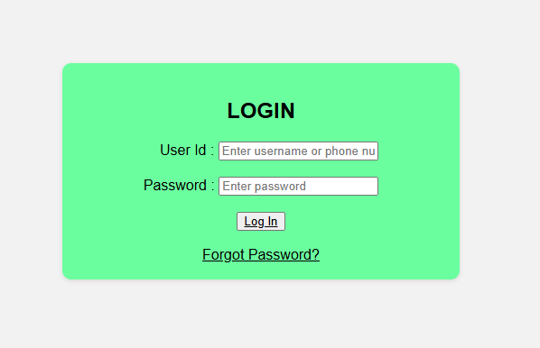
Login Page

Slide 8
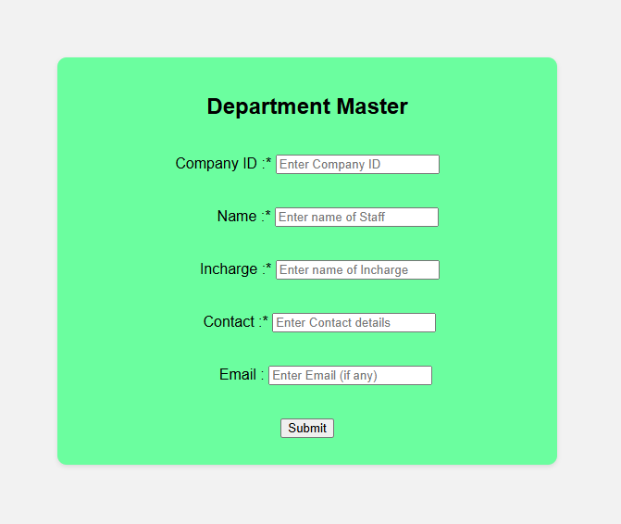
Department Master

Slide 9
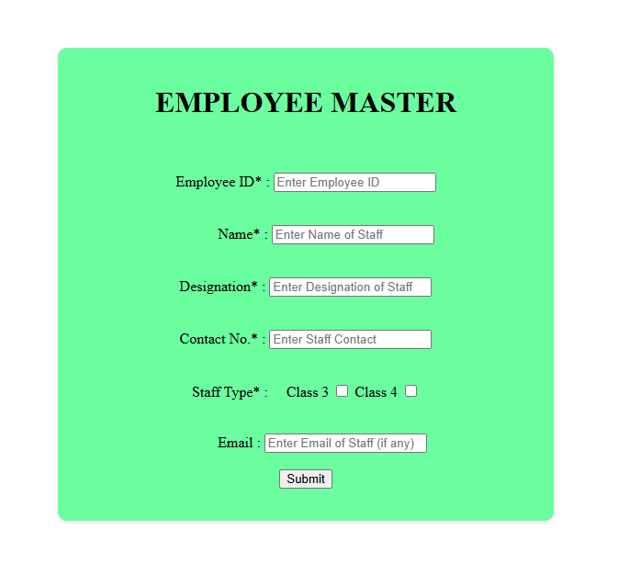
Employee Master

Slide 10
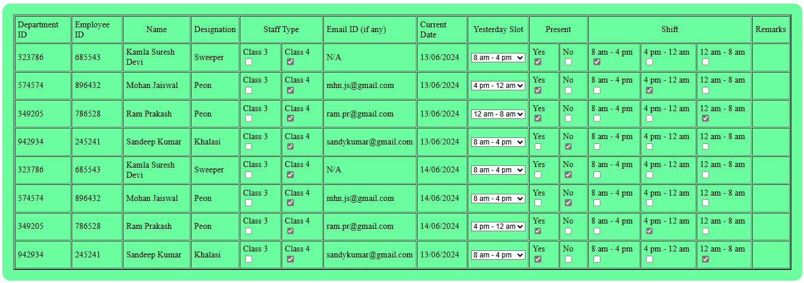
Schedule

Slide 11
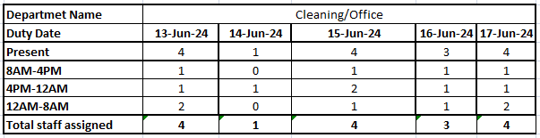
Summary of Duty Register

Slide 12
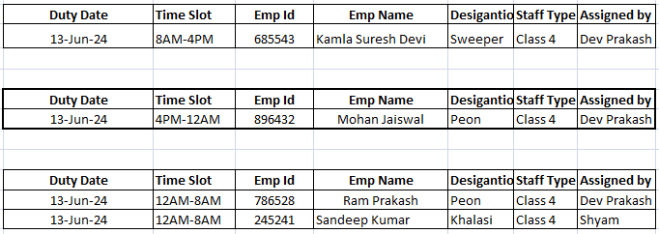
If we Select particular date and time slot Detailed Duty Register

Slide 13
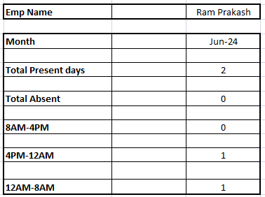
Monthly Employee Status

Slide 14
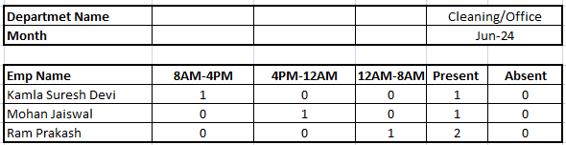
Monthly Department Status

Slide 15
Conclusion
In conclusion, creating a duty roster is an important task for any organization. It helps ensure that employees are working efficiently and effectively.

Slide 16
Thank You

